Slide 1

COMPUTER SCIENCE STUDENTS ACADEMICS
BY:
VAISHNAVI V

Slide 2
OBJECTIVES
To design, populate, and query a comprehensive student database that reflects the academic and technical profiles of Computer Science students.
This project focuses on storing and retrieving structured data regarding students’ academic performance (GPA), their domain interests, hands-on projects, future career goals, and proficiency levels in core programming languages .
Efficiently manage and organize student data using SQL.
Analyze student strengths based on domain interests and language proficiency.

Slide 3

QUESTION RELATED TO DATASET

Slide 4
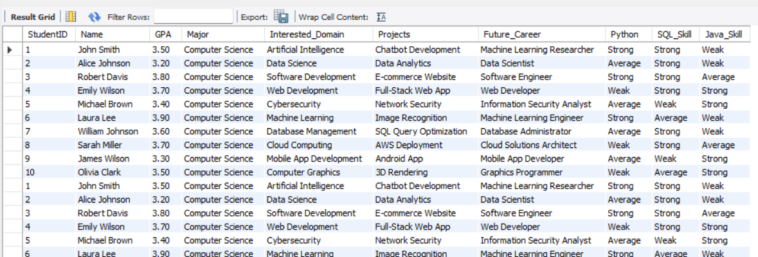
TABLE 1

Slide 5
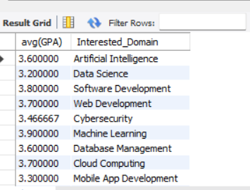
1.AVERAGE GPA OF STUDENTS BASED ON THEIR INTERESTED DOMAIN
QUERY:
This query helps us to know the average GPA of students in each domain

Slide 6
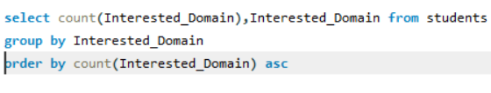
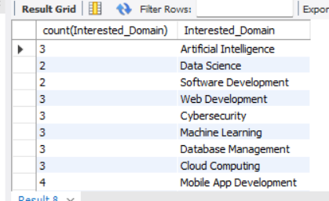
2.COUNT THE NUMBER OF STUDENT IN EACH DOMAIN
QUERY:
From this we will know how may students are interested in each domain

Slide 7

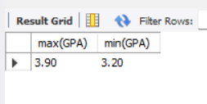
3. WHAT IS MAXIMUM AND MINIMUM GPA
QUERY:
This query helps us to get the maximum and minimum GPA.

Slide 8
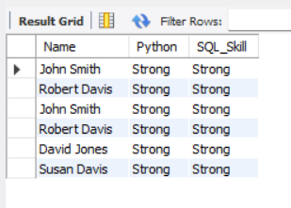
4. LIST NAMES OF STUDENTS WHO ARE STRONG IN PYTHON AND SQL
QUERY:
This query helps us to know about the names of students who are strong in Python and SQL

Slide 9
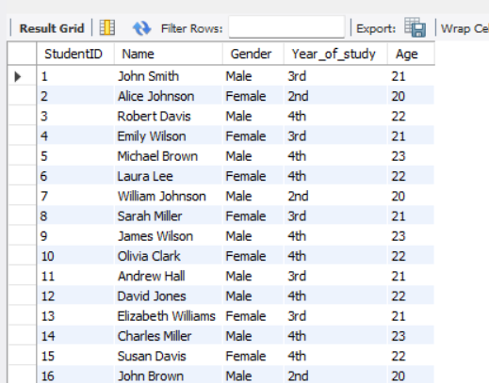
TABLE 2

Slide 10
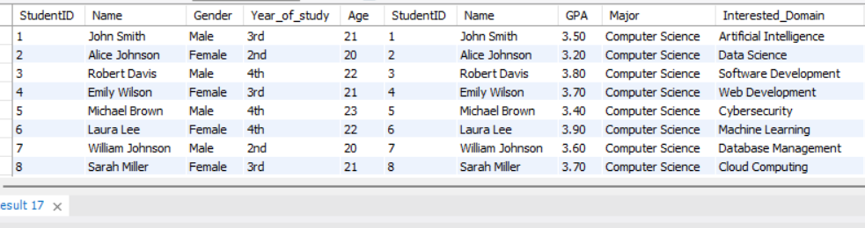
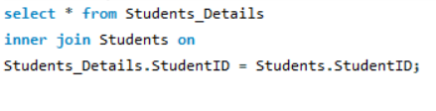
5.COMBINE DETAILS FROM BOTH THE TABLE QUERY:

Slide 11
CONCLUSION
This SQL-based student database system successfully showcases how structured queries can extract valuable insights from academic and skill-related data.
The project highlights the importance of structured data management in education and career planning, proving SQL to be an essential tool for storing, querying, and analyzing student performance and professional readiness.

Slide 12
THANK YOU

